Slide 1
European Reform University Alliance Staff week Open Science 11 May ,2021

Slide 2
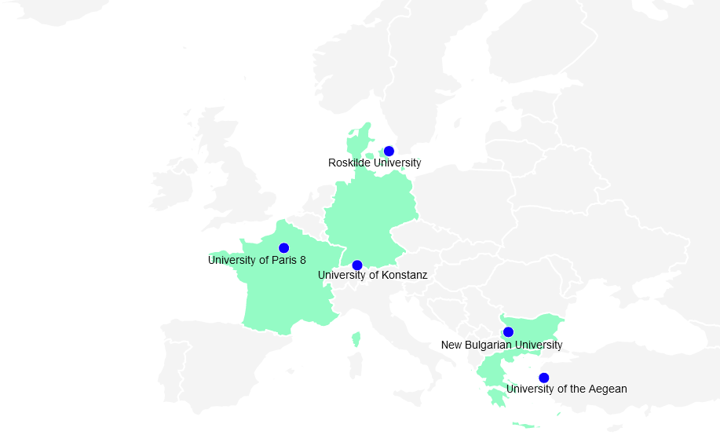
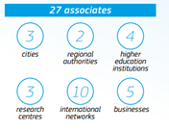
We are ERUA
ERUA is part of the European Universities Initiative launched in 2019 by the European Commission
5 partners - University of Paris 8 Vincennes - Saint-Denis (France)
University of Roskilde (Denmark)
University of Constance (Germany)
University of the Aegean (Greece)
New Bulgarian University (Bulgaria)
Selected for their reformist orientation and alternative and experimentalist approaches
Long-term vision to build the university of the future based on two key pillars:
- Training (ERUA Erasmus+)
- Research (ReERUA H2020)

Slide 3
ERUA vision
We share a vision of universities as creative spaces, an awareness of the power of experimental approaches, and an understanding of the promises of diversity. To address the challenges and problems of today, we want to bring together academics from all over Europe and students from the top and bottom socio-economic deciles, from rural and urban settings, from local and global backgrounds.
Together we aim to shape a more just, open and inclusive society.

Slide 4
ERUA mission
We offer students a rich and diverse environment with a shared pedagogical approach focused on project-based learning, societal challenges and critical thinking.
We develop personalised learning pathways in a multilingual and inter-cultural environment.
We pursue excellence in research by promoting free thinking, a bottom-up approach and open science. We cover most disciplinary fields with a particularly strong profile in the Humanities, Social Sciences and Arts. This enables us to develop original interdisciplinary approaches and new answers and solutions to contemporary problems and challenges.
Our educational programmes and research projects are geared towards societal impact.
As Reform Universities we continuously question and transform our institutions. We foster the critical function of the modern university by reflecting upon, assessing and advancing alternatives to current models.

Slide 5
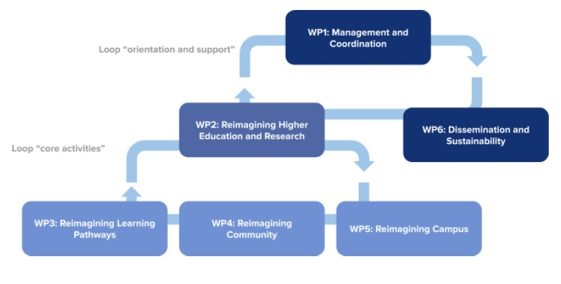
Presentation of the different work packages and activities
Work package 1: Management and Coordination University of Paris 8
Work package 2: Reimagining Higher Education and Research Roskilde University
Work package 3: Reimagining learning pathways University of Paris 8
Work package 4: Reimagining the community University of Konstanz
Work package 5: Reimagining the campus University of the Aegean
Work package 6: Dissemination and sustainability New Bulgarian University
A step by step co-creation path:
Mapping - mutual understanding
Sharing – capitalization of expertise
Innovating – build together for the Alliance
Notes:
All working group are well established, after a slow start mainly related to recruitments
Activities are on track,

Slide 6
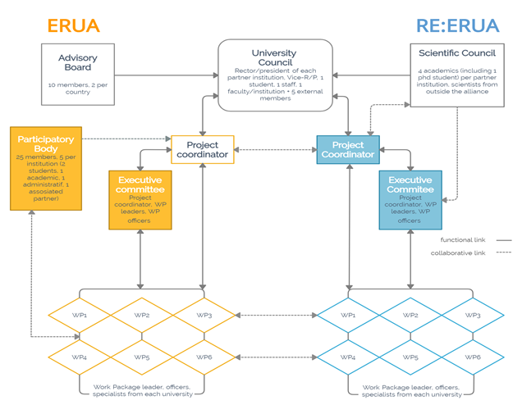
WP1 - Management and Coordination
Objectives:
1. build a flexible and participatory alliance
2. establish an administrative and financial structure to ensure the smooth running of activities
3. design a common quality assurance to support and ensure the sustainability of ERUA
Notes:
collaborative open source platform,
Reporting procedure, regular meetings, QA policy and guideline
Integretion with Re-ERUA
Student participation UC, Ambassadors, WP, ecc..
Flexible QA + participatory body

Slide 7
WP2 - Reimagining Higher Education and Research
Stimulate the culture of innovation within the Alliance and support experimental approaches for teaching, learning as well as research
Objectives:
Teaching and learning: create common infrastructures to exchange information on innovation in teaching Observatory on teaching and learning innovation – and to foster new experiments - “Sandbox” for teaching and learning experimentation
Research: Develop new formats for research in the SSH to scale up existing competences, foster a challenge-based interdisciplinary approach and increase impact
Think Tank on the impact of the Social Sciences and Humanities
Project Development Unit
Notes:
Mapping

Slide 8
WP3 - Reimagining learning pathways
Develop a new ecosystem that will combine our respective education and training offerings with the successful experiments conducted by WP2 in an innovative integrated framework
Objectives:
Intensive courses
Semester courses
Travelling seminars
Joint programmes
Pre-doctoral training programme
Service learning
Commun e-learning platform
Enable students to design their own learning pathways through uniquely flexible combinations of courses

Slide 9
WP4 - Reimagining the community
Create a strong, cross-campus community based on shared values, knowledge, language and interests among students, faculty, researchers and non-academic staff
Objectives:
Empower academic and non-academic staff
Standardise support structures for student mobility
Conceive a shared language policy
Interculturality
Support diversity
Notes:
inclusion one of our strengths

Slide 10
WP5 - Reimagining the campus
3 flagships to connect and engage ERUA university campuses as well as ERUA with the outside world (associated partners, networks, civil society, etc.):
Digital Reform within ERUA - Digitally connected Campuses, digital mobility, creative digital partnerships and sustained engagements with Regions and Societies
Aeiforia in ERUA: Enable Sustainable Synergies between ERUA partners, Local Societies and Regions for better impact - a “Connected way of Thinking”
Bauhaus in ERUA: green and digital transformation - building bridges between technology and culture
Notes:
The ERUA Alliance Protocol for the achievement of the 2030 Agenda
Feasibility study for digital connectivity
Virtual Hub ERUA for students
ERUA Science & Art e-Gallery
ERUA Students Science & Art Network
Science shops
ERUA Cultural Network

Slide 11
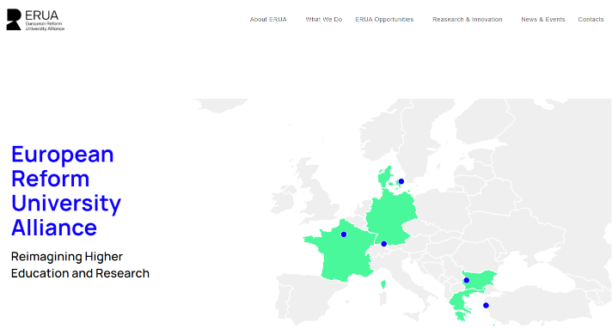
WP6 - Dissemination and sustainability
Develop and implement an Alliance communication and multilingual strategy
Sustain the long term vision of the European university
Promote the results of the Alliance to the different ERUA communities and external stakeholders through efficient digital tools
WP6 ensure that all project-related publications comply with the principles of open science, open access and open data and to define how we will disseminate our project results beyond the Alliance, acting as a role model.
Our website : www.erua-eui.eu
Our presence on social medias :
ERUA newsletter

Slide 12
Re:ERUA : Research and Engagement for the European Reform University Alliance
Research Pilar of the Alliance
H2020 Funding Program : SwafS - Science with and for Society
October 2021
Objectives :
To Strengthen the Strategy of the European Reform University Alliance
a joint strategy for an engaged and responsible R&I community,
common values and a joint vision of a community of reform universities
close links between academia, research and civil society

Slide 13
6 Re:ERUA Work Packages
WP1 Coordination
WP2 To Develop an Engagement Strategy for Research and Innovation (R&I)
WP3 Foster the Engagement for a Responsible R&I
WP4 Foster human capital for Europe
WP5 Create an Open Science toolbox
WP6 To connect the five universities

Slide 14
WP2: Engagement strategy for the areas of research and innovation
WP Leader : UP8
Objectives
❶ To Identify new ways of steering research and inventive cooperation formats
To foster a Research cooperation within ERUA (Students / Researchers and Support staff)
❷ To Identify thematic and methodological points of convergence to build and implement our Research Engagement Strategy
Main Activities :
Common Research portal to easily find colleagues within the Alliance
Network of Research Support Offices operational
Charter on a common research framework program and guidelines for best practices
Engagement strategy and roadmap

Slide 15
WP3: Innovation and societal engagement
Leader : RUC
Objectives
❶ To Foster the engagement for Responsible Research and Innovation (RRI) of all sectors’ organizations and citizens through :
Good governance, mutual learning, agreed practices and multi-actor and public engagement initiatives.
❷ To Analyze current practices / projects and Outline future possibilities.
Main Activities :
Interactive catalogue of ideas/approaches to social innovation/co-creation
Roadmap and Recommendations for innovation and societal engagement
Final Seminar presenting results as well as the roadmap and future development

Slide 16
WP4: The Alliance as an engine for Human capital
Leader : UAegean
Objectives
❶ To Develop a common framework for re-skilling and up-skilling researchers/scientists and stakeholders, to strengthen the human capital in R&I
❷ To Support regional skills in innovation & entrepreneurship
❸ To encourage Inclusion and diversity (Focus Gender)
Main Activities
Survey report and analyze of needs
Action Plan for Training Programs for re-skilling and up-skilling
Gendered innovation Training and mentoring programme
Digital Conference on Gendered innovation

Slide 17
WP5: Open science for transparent research and public engagement Leader : UKON
Objectives
❶ To foster the idea of Open Science within the Alliance
❷ To build structures to work together in all aspects of Open Science.
❸ To identify the needs of the researchers regarding that specific topic
❹ To prepare technical services, digital technologies and new collaborative tools.
Main Activities
Open Science SWOT analysis
Monthly Science Live MeetUp
Open Science Online Course
Identify OS Ambassador in each university of the Alliance

Slide 18
WP6: Sharing infrastructures and ressources and develop common structures
Leader : NBU
Objectives
To Create a strong research and innovation community within ERUA by connecting people, networks and resources
To build shared infrastructures based on common R&I values
Main Deliverables
Mapping of R&I internal and external (infra)structures, resources and networks
Creation of virtual and physical meeting spaces dedicated to joint research initiatives
Infrastructure sharing procedures document
updated databases for connecting collaboration offers

Slide 19
Re:ERUA - Main activities connected with ERUA Erasmus+
Networks
Staff, Students and Researchers
Online Research portal
Gender and Inclusion
Data Management Plan / Research Data Management
Open Science Ambassador in each university of the Alliance
Open Science Meet’up and Training
Libraries Network
Cross-disciplinarity
Open Science
Conferences / Workshops / Seminares
Charters engaged and responsible R&I
Digital Platforms
Training for young researchers

Slide 20
Open science: a key approach of scientific research
ERUA committed to the principle of open science, open access and open data in research.
ERUA plans to stimulate the exchange between librarians from each university of the Alliance and enable them to share knowledge and best practices
Data Management Plan / Research Data Management
Open Science Ambassador in each university of the Alliance
Open Science Meet’up and Training
ERUA undertakes to deposit publication material in all of our libraries
ERUA ensures that all project-related publications comply with the principles of open science, open access and open data and to define how we will disseminate our project results beyond the Alliance, acting as a role model.

Slide 21
Open Educational resources
ERUA acknowledges the importance of open education as an alternative to traditionally offered
training through formal education systems, therefore it designates open dissemination of
knowledge as a main objective of its activities. Using open education resources, ERUA will develop digital material, such as:
MOOCS
SPOCS
online and blended programs
which will be introduced with an open license to the public and will have as a result the increase of its influence beyond the consortium.

Slide 22
Citizen science
Finally, citizen science, having emerged as a key paradigm in recent years, is of particular interest to ERUA.
We will therefore develop various kinds of related activities such as science shops, experience-based learning, etc., aiming to reinforce the links between ERUA academia and civil society.
We are planning for all documents, data and any other material of public nature emerging from ERUA to be made freely available on open access repositories hosted on joint platforms in keeping with the General Data Protection Regulation with free access for all interested parties.

Slide 23
Thanks for your participation
À bientôt
Bis bald
See you soon
до скоро
Τα λέμε σύντομα
Vi ses snart

