Slide 1
Open Science at
New Bulgarian University
.............................................................….
Radostina Todorova, PhD, Library Director

Slide 2
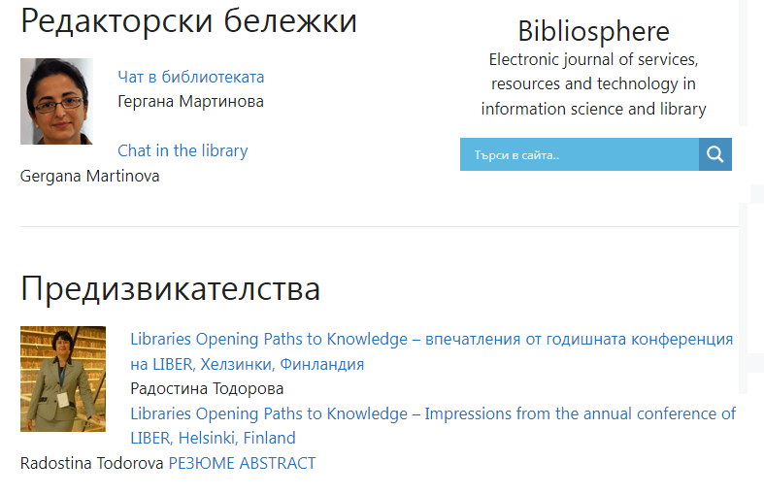
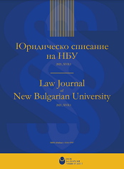
The Beginning
In 1999, the NBU Library initiated a project, supported by the entire academic community of the university, for electronic publication of open access periodicals, or so-called "Gold open access".
In 2005, the Scholar Electronic Repository of the New Bulgarian University was launched, providing so-called "green open access" to the scholarly and creative product created at the university, where authors can archive their works independently.
Notes:
In 1999, the NBU Library initiated a project, supported by the entire academic community of the university, for the electronic publication of open access periodicals, or so-called "Gold open access". The project continues today with the journals "Bibliosphere: electronic journal of services, resources and technology in information science and library", which is the first open access journal in the field of library science in the country, and "Law Journal of New Bulgarian University", which is the first open access journal in the field of law in Bulgaria.
In 2005, the Scholar Electronic Repository of the New Bulgarian University was launched, providing so-called "green open access" to the scholarly and creative product created at the university, where authors can archive their works independently. Scholar Electronic Repository of the New Bulgarian University is the first of its kind Institutional repository created in Bulgaria.

Slide 3
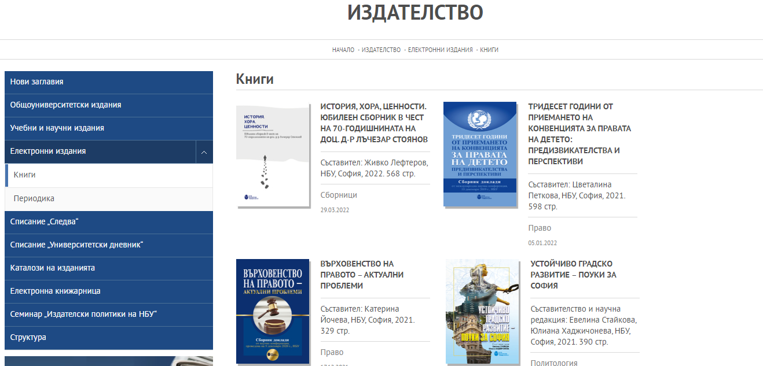
NBU Publications and Open Access
The NBU publishing house publishes open access publications.
These are: monographs, textbooks, conference proceedings, periodicals, yearbooks and journals.
The section is divided into two parts: books and periodicals.
Books
Periodicals
Notes:
The NBU publishing house publishes many open access publications. These include monographs, textbooks, conference proceedings, periodicals, yearbooks and journals. The publishing house has a special section on its website where the full text files of the publications are published. This section is divided into two parts: books and periodicals.

Slide 4
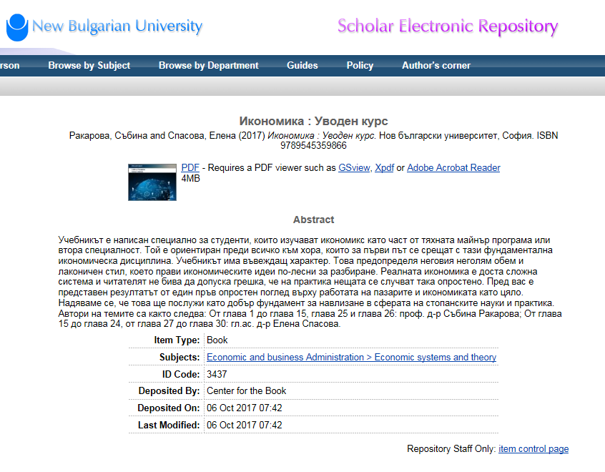
NBU Publications and Open Access
Since 2016 all monographs and textbooks are deposited in the Scholar Electronic Repository of the New Bulgarian University.
This ensures:
permanent storage,
reliable indexing,
promotion;
ensuring accessibility to the scientific works of NBU scientists on the global network.
Indexing in the Scholar Electronic Repository of the New Bulgarian University takes place immediately after publication on the Publisher's website.
Librarians from the NBU Library include absolutely all metadata in the record structure, as well as the full text of the publication.
The full text of Book
Notes:
In 2016 it was decided to deposit all monographs and textbooks in the Scholar Electronic Repository of the New Bulgarian University. This ensures permanent storage, reliable indexing, which aims to promote and ensure the availability of the scientific works of the NBU scholars on the global network. Indexing in the Scholar Electronic Repository of the New Bulgarian University is carried out immediately after publication on the Publisher's website by librarians from the NBU Library.

Slide 5

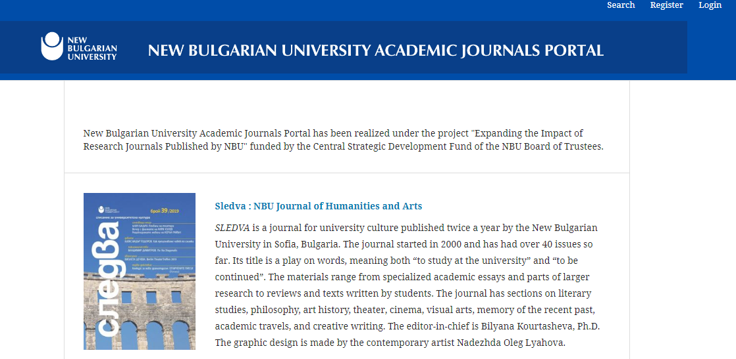
New Bulgarian University Academic Journals Portal
New Bulgarian University Academic Journals Portal has been realized under the project "Expanding the Impact of Research Journals Published by NBU" funded by the Central Strategic Development Fund of the NBU Board of Trustees.
Notes:
From the beginning of 2019, the aim is to publish all issues of open access journals through the New Bulgarian University Academic Journals Portal. This ensures permanent storage, reliable indexing, which aims to promote and ensure accessibility to the scientific works of NBU scientists on the global network. The implementation of the project "Expanding the Impact of Research Journals Published by NBU" , funded by the Central Strategic Development Fund of the NBU Board of Trustees, creates real conditions for increasing the visibility and usability of NBU scientific periodicals by the academic community at home and abroad. The creation of the "New Bulgarian University Academic Journals Portal", in addition to bringing together the independent newly created sub-sites of NBU periodicals, facilitates online publishing and creates conditions for indexing the generated scientific content on the Internet.

Slide 6
New Bulgarian University Academic Journals Portal
The New Bulgarian University Academic Journals Portal has been created and operates on an open source platform "Open Journal Systems".
The aim is for each open access periodical of the NBU to have its own sub-site.
All publications are indexed in Latin (predominantly English) to the author and title level of the individual article.
In 2019, NBU Publishing became a full member of Crossref. The NBU prefix: 10.33919. and the suffix is formed by the librarians of the NBU Library and is composed of the abbreviated name of the publication, year and serial number of the article.
The portal can be accessed from the homepage of the NBU website, in the "Book Centre" section, as well as on the Library website, in the "Electronic Resources" menu.
Notes:
The "New Bulgarian University Academic Journals Portal" has been created and operates on the basis of an open source platform "Open Journal Systems". It is stored on a server at the University. The aim is that each NBU periodical has its own sub-site. In the portal, all journals are indexed in Latin (predominantly in English) down to the author and title level of an individual article. The system offers simultaneous search of all periodicals by author or keywords in the title.
Indexing in the New Bulgarian University Academic Journals Portal is done immediately after publication on the Publisher's website by librarians from the NBU Library.
In 2019, the NBU Publishing House became a full member of Crossref, an international independent association of publishers of academic and professional journals. Membership allows all articles in NBU electronic periodicals to be assigned unique identification numbers from 2019 onwards. Thus, each publication can be accurately cited thanks to its unique DOI.
The NBU prefix: 10.33919. and the suffix is formed by the librarians of the NBU Library and i is composed of the abbreviated name of the publication, year and serial number of the article.
The portal can be accessed from the home page of the NBU website, in the Book Centre section. A link has been created on the Library's website, in the "Electronic Resources" menu. An additional link to the individual periodical level will also be provided from the individual department pages on the English version of the NBU website. Information about the Bulgarian language editions is available as before on the pages of the respective departments and on the publisher's website.
The implementation of the project creates real conditions for increasing the visibility and usability of the NBU scientific periodicals by the academic community at home and abroad. The creation of the New Bulgarian University Academic Journals Portal, besides uniting the independent websites of the NBU periodicals, facilitates online publishing and creates conditions for indexing the content on the Internet.

Slide 7
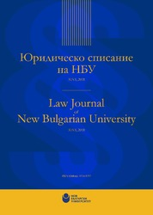
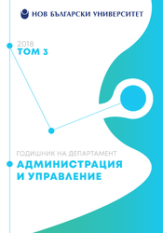
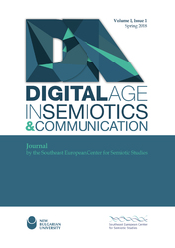
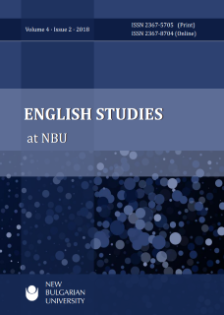


Publishing and Open Access
1. Each issue is submitted for review by the Publishing Board, which approves the prepress and publication procedure.
2. Registered valid ISSN (print) or ISSN (online).
3. Clearly defined objectives and scope.
4. Editor-in-chief and editorial board with habilitated Bulgarian and foreign scientists.
5. Publishing policies including open access information, guidelines for authors, citation standard and manuscript layout template.
6. Evaluation of scientific content by reviewers.
7. Arrange the main elements in the articles in a certain way.
8. Translation of the author's name, article title, keywords and abstract into English.
9. Regular publication, on a predetermined schedule.
10. Website with full information about the publication, contact details for the editorial board and mailing address.
Notes:
Within the framework of the project "Expanding the Impact of Research Journals Published by NBU" , funded by the Central Strategic Development Fund of the NBU Board of Trustees, a 33-question survey has been implemented to establish the current status of NBU journals. All 24 periodicals identified participated in the survey. An analysis of the status of the publications was prepared. A set of exemplary publishing policies and specific development recommendations for each individual periodical was developed, taking into account the information provided by the trainers during the workshop "Successful academic periodicals - publishing, indexing and referencing" and the data collected about the publications in the survey. A number of meetings were held with the hunger editors and editorial boards of the journals during which the ten main recommendations for the development of the journals were discussed, namely: (the recommendations are indicated on the slide).

Slide 8
Indexing in CEEOL
The Central and Eastern European Online Library (CEEOL) is a repository of full text indexed documents from and about Central and Eastern Europe.
Since 2016 NBU is in contractual relations with CEEOL .
The system provides bilingual indexing of journals, yearbooks and periodicals. Indexing is in the original language of the publication and in English.
Open access publications are indexed in the system by librarians in the NBU Library, according to the specific requirements of the database.
The collaboration provides for the included open access NBU publications:high visibility and awareness:
  full text indexing by Google Scholar, Primo® and Summon® (ProQuest);
  opportunity to reach new audience through CEEOL´s institutional and individual subscribers;
  usage statistics on article level.
Notes:
The Central and Eastern European Online Library (CEEOL) is a repository of full text indexed documents in the fields of Humanities and Social Science publications from and about Central and Eastern Europe. The collections include native language sources from and about Central, East and Southeast Europe's humanities and social sciences in the form of journal articles, eBooks and Grey Literature. The database is extremely popular in Bulgaria as it presents the scholarly output of almost all academic publishers in the country.
Since 2016, NBU has been in a contractual relationship with CEEOL for the purpose of bilingual indexing of journals, yearbooks and periodicals. Indexing is usually in the original language of the publication and in English.
In the framework of "Expanding the Impact of Research Journals Published by NBU", an additional annex has been signed to cover 21 of the 24 participating journals. New issues published in 2019 of these journals to be included in the database immediately.
Open access journals are indexed into the system by NBU Library librarians according to the specific requirements of the database.
The collaboration provides for the included open access editions of the NBU:
- high visibility and awareness
- full text indexing by Google Scholar, Primo® and Summon® (ProQuest)
- opportunity to reach new audience through CEEOL´s institutional and individual subscribers
- usage statistics on article level.

Slide 9
Scholar Electronic Repository of the NBU
NBU NEA's mission is to be a single open electronic space providing long-term preservation of electronic documents and contributing to the dissemination of scholarly results of faculty and graduate students on the World Wide Web.
The archive is part of the international Open Archives Initiative (OAI) and follows the recommendations of the European University Association (EUA) to promote an institutional policy encouraging the free exchange of knowledge.

Slide 10
History of Scholar Electronic Repository of the NBU
The project was implemented under the HESP programme of the Open Society Institute.
In 2005, a dedicated server was set up and a workshop was held for the team creating the repository.
In 2006 Eprints, the open source software chosen by the NBU, was installed using the original English interface.
A team of administrator and archive manager has been formed.
Deposit rules and a deposit agreement are developed and signed electronically between the NBU and the author.
A job guide designed for university lecturers and students was compiled in 2007.
In the year 2007, experimental deposit of materials in the archive began.
The repository is registered in OpenDOAR under the name New Bulgarian University Scholar Electronic Repository.
Notes:
The project for the creation of the repository was implemented under the HESP programme of the Open Society Institute. In the framework of the project, a special server was set up in 2005 and a workshop was held on the team that creates the repository. The following year, 2006, the NBU's chosen open source software, Eprints, was installed using the original English interface. The software's functionalities clearly delineated the role of the administrators and the archive's administrator. Deposit rules and a deposit agreement were developed and signed electronically between the NBU and the author. A manual for the university's faculty and staff was drafted in 2007. The same year, the eĸcpeĸntal deposit of materials in the archive began. As a result, the first 25 publications are available to help with the demonstration of the repository to the academic staff of the university.
The repository is registered with OpenDOAR under the name New Bulgarian University Scholar Electronic Repository. In OpenDOAR, it is defined as institutional and multidisciplinary.

Slide 11
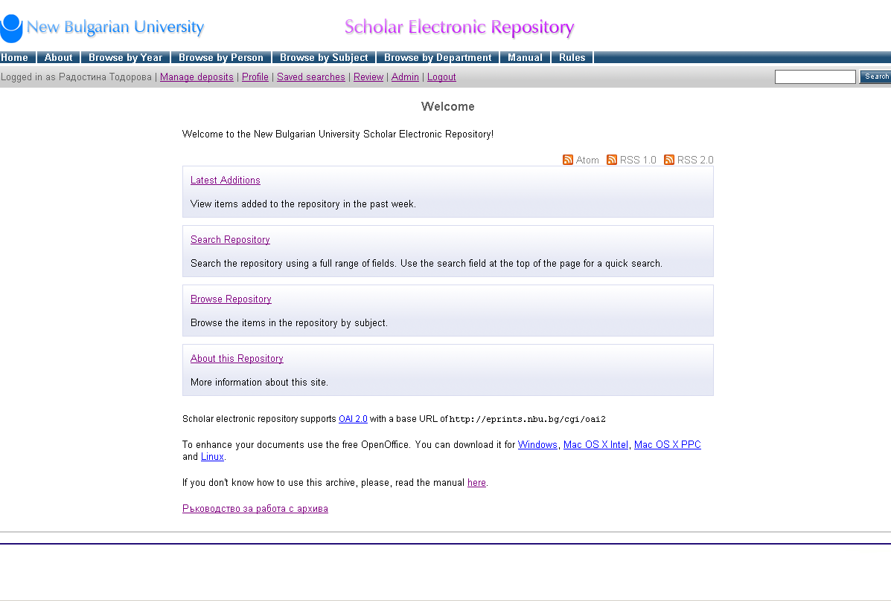
Scholar Electronic Repository of the NBU
Notes:
The software used to build the NBU Scientific Electronic Archive is Eprints. It is one of the popular software for building institutional repositories, besides the specialist administrators it is also significantly user-oriented. The developers are constantly striving to remove barriers to depositing scholarly content, but also to create mechanisms to improve the quality of metadata and generally ensure the information value of the digital archive by reducing the time to deposit, the ability to import data from other repositories or through other services, auto-populating fields for faster data entry, and name authority control. The system adheres fully to the principle of single entry and reuse of data. It can work in conjunction with other 'bibliographic manager' type systems, various desktop and Web 2.0 applications, RSS feeds and email notification. Users can easily compile bibliographies according to different criteria and in different formats, export data, generate their own RSS feeds and integrate them into other web applications.
The system also has many features such as:
- Archive browsing by year
- Scrolling by author
- Browse by subject
- Scroll by Department
- Most Recent Entries
- Search the archive

Slide 12
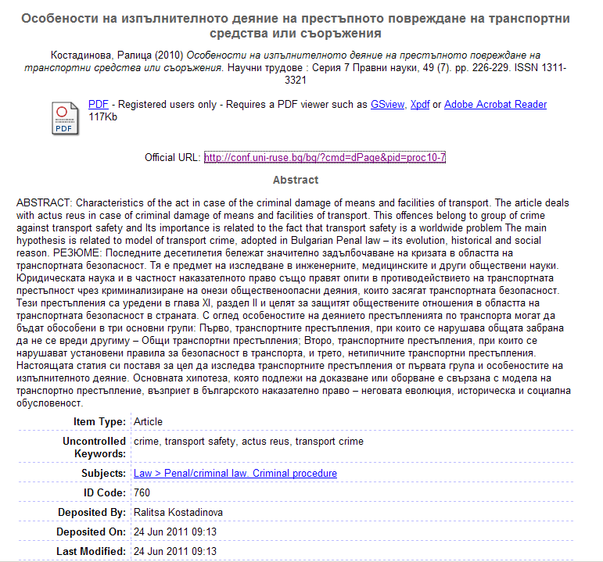
Record elements in the repository
Title;
Bibliographical description;
File format;
Internet address of the publication;
Abstract;
Document type;
Subject headings;
Document ID;
Tt whom deposited;
When it was deposited;
When it was modified.

Slide 13
Development of NBU SER
Number of deposited documents (cumulated) in the NBU repository
Notes:
It is clear that despite the voluntary nature of the deposit, the number of documents deposited in the repository is steadily increasing. From the first 25 deposited experimentally in 2007, the number of deposited documents has increased. At the end of 2021, 3 200 documents are stored there.

Slide 14
Popularity of NBU SER
Number of visits and unique visitors to the repository by year
Notes:
It is worth mentioning here that all traffic (from registered and unregistered users) on NBU's NEA is analyzed by the web-based piwik system. The year-wise data presented in the figure shows sustained interest in the documents deposited in the system, and the users are from all over the world.

Slide 15
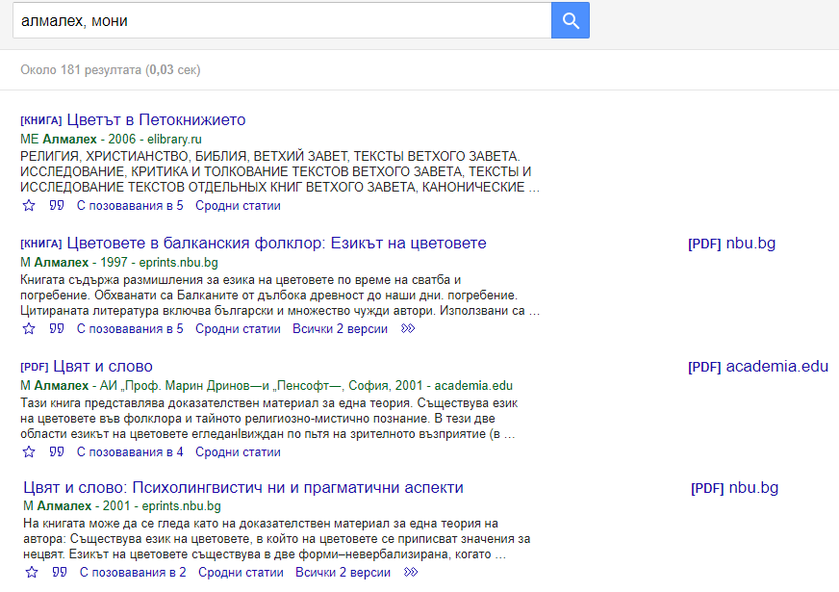
Visibility
The global visibility of open publications makes them more readable than those not available on the web.
Sable access impacts popularity, and in turn it leads to greater influence.
Authors gain this visibility through priority indexing of documents from institutional repositories, from systems such as Google Science.
The archive team also plays an active role in information dissemination by involving the NEA in information infrastructure projects.
Notes:
The global visibility of open publications makes them more readable than those that are not available on the web. Thus, open access has an impact on popularity, and in turn it leads to greater influence, which also means more frequent reference - i.e. citation. Authors gain this visibility thanks to the priority indexing of documents from institutional repositories that is provided by search engines such as Google science.
The archive team plays an active role in information dissemination by involving the NEA in information infrastructure projects.

Slide 16
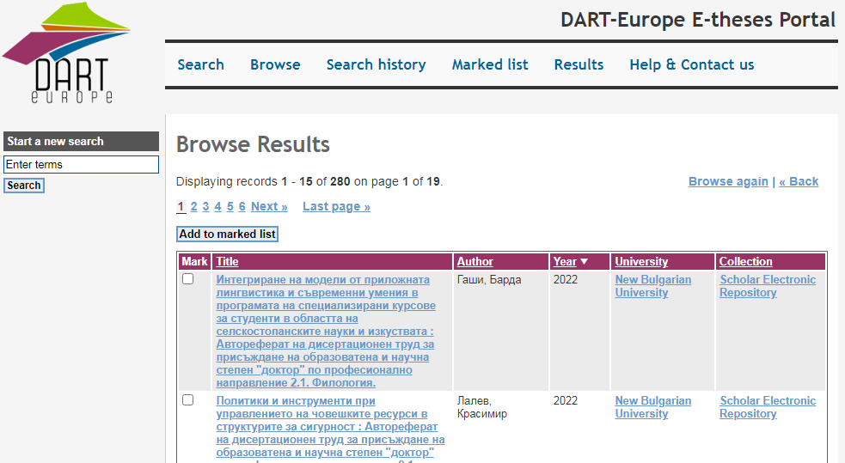
Transferring metadata to the DART-Europe Portal
NBU is the first Bulgarian university included in this project.
The transfer is via the OAI-PMH protocol and the data format is OAI Dublin Core.
DART Europe collects metadata on a daily basis by extracting information according to a document type criterion, namely dissertation.
The only requirement for project participants is that the so-called OAI Base URL of the repository is provided.
Notes:
NBU is the first Bulgarian university included in this project. The data transfer is done through the OAI-PMH protocol and the data format is OAI Dublin Core. DART Europe's European Portal for Electronic Theses and Dissertations collects metadata on a daily basis by extracting information according to the criterion of document type, namely dissertation. The only requirement for project participants is that the so-called OAI Base URL of the repository is provided. Currently, information on 280 dissertations and abstracts is available in the portal.

Slide 17
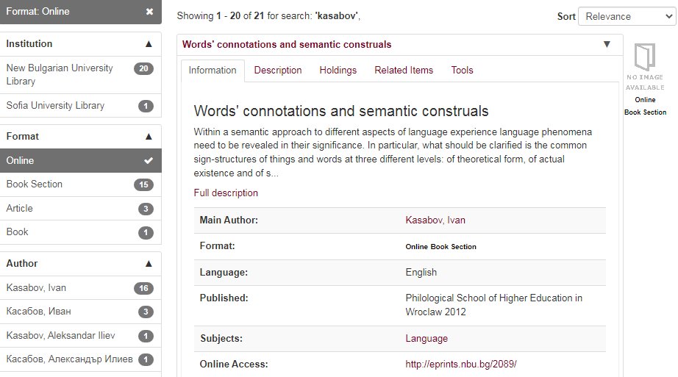
Transferring metadata to the NALIS catalogue
NBU is the first university to include its institutional archive in this catalogue.
Data transfer to the National Academic Library and Information System (NALIS) is performed in an identical manner.
The integration of this new dataset contributes to facilitating access to scientific publications at national level.
The transfer is performed once a week by retrieving data according to a criterion - document status - published.
Notes:
NBU is the first university to include its institutional archive in this catalogue. Data transfer to the National Academic Library and Information System (NALIS) catalogue and information system is carried out in an identical way. These are mainly descriptions of scientific articles, parts of books, even whole monographs. The integration of this new information set contributes both to enrich the NALIS catalogue and to facilitate access to scientific publications at the national level. The descriptions are accompanied by links to the full texts of the documents. Currently, the transfer is performed once a week by retrieving data according to a criterion - status of the document published.

Slide 18
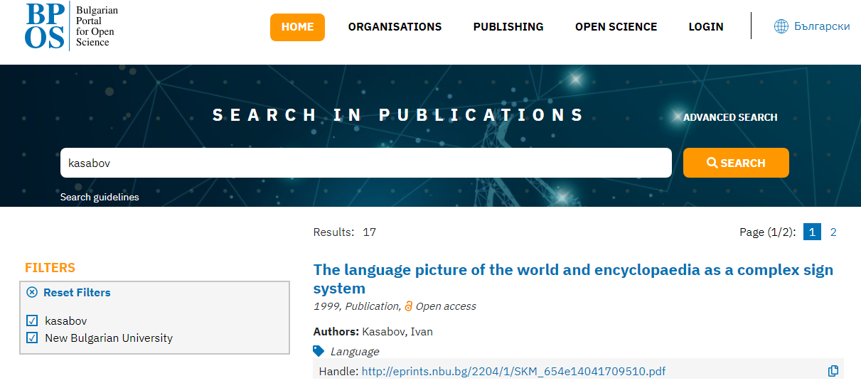
Transferring metadata to the BPOS
Notes:
The Bulgarian Portal for Open Science aims to coordinate the dissemination of open access scientific results from publicly funded research and fosters the efforts of all scientists that wish to share their research outputs. The main purpose of the initiative is to provide faster and seamless sharing of publications and other digital research outputs and thus strengthen the communication and collaboration between scientists. The initiative aims to open opportunities for new levels of integration and raise awareness in order to build a global, sustainable and cooperative Open Science.
The system aims to provide coordination and connectivity with other European infrastructures for open access to scientific information. In compliance with the latest interoperability standards the resources of the Bulgarian Portal for Open Science are indexed by OpenAIRE. The development of the Portal and the integration with OpenAIRE infrastructure is an important step towards the active participation of the Bulgarian research community in the European open science cloud (EOSC) initiative. The metadata in the national repository is described using Dublin Core and DataCite Metadata Schema in accordance with OpenAIRE Guidelines. Currently the automatic transfer of data from the Scholar Electronic Repository of the NBU to the Bulgarian Portal for Open Science is performed once a week, retrieving data according to a criterion - status of the published document.

Slide 19
The library supports research
The New Bulgarian University Library develops many services to support scholars during their research. These are:
Delivery of Items.
Journal E-mail Alerting Service.
Librarian Assisted Access to Databases.
Order of items.
Bibliographic Reference.
Bibliographical Formatting.
Citation Analysis.
Advice on copyright issues and open access publishing
Consultancy for indexing and referencing academic journals.
Advice on the choice of citation standards.
Notes:
The New Bulgarian University Library is one of the few libraries in Bulgaria that systematically develops a variety of services to support scholars during their research:
- Through Delivery of Items faculty receive via e-mail journal articles, newspapers, digests or chapters from a book from The Library Catalogue and Catalogues from other libraries, all in PDF format.
- To receive current alerting with the table of contents of new issues of journals - use this service.
Librarian Assisted Access to Databases. If the faculty not acquainted with the main principles of browsing and searching in different databases, you can ask for assistance.
- Order of items needed for research activities through the purchase of books and audiovisual materials, subscriptions to periodicals and databases.
- Bibliographic Reference is a bibliographic reference list of literature in the field that you are interested in. It can contain books, articles from periodical publications from The Library Catalogue and Catalogues from other libraries. NBU Library owns ready bibliographic references for different fields which you can choose from or make your own request.
- Bibliographical Formatting is a Formatting a bibliography of works according to preferred bibliographic standard.
- Citation Analysis. This service includes creating a personal account of the author into different bibliographic information systems and defining their publications. Preparing a comprehensive citation analysis based on information gathered from the bibliographic systems and the Internet. Authors are provided with comprehensive training for using the databases, as well as how to add posts, set up email alerts and do citation tracking in the future.
- Consultation on copyright issues and open access publishing
- Advice on indexing and referencing academic journals.
- Advising on the choice of citation standards.
All services are offered electronically, so face-to-face contact between librarian and scholar may not be possible.

Slide 20
International Open Access Week
As part of initiatives to encourage authors, promote open access to scholarly information and the institutional scholarly archive, NBU celebrated International Open Access Week for the first time in 2010.
In 2010, a special advertising and information campaign was organized to promote depositing in the University's Scholarly Electronic Archive.
In 2013, the International Open Access Week campaign was for the first time conducted entirely online through the NBU Library's social media.
In pandemic 2020, the theme of Open Access Week is "Open with Purpose: Taking Action to Build Structural Equity and Inclusion". The opening of the initiative took place electronically in Zoom, and the NBU Scientific Electronic Archive (NBU SEA) and its integration of other information infrastructures such as NALIS, DART-Europe and BPOS were presented on the different days.
Notes:
As part of the initiatives to encourage authors, promote open access to scientific information and the institutional scientific archive for the first time in 2010, from 19 to 23 August, the NBU Library is celebrating the International Open Access Week.
A special campaign was organized to promote deposit in the University's Scientific Electronic Archive. Printed and electronic materials with the campaign logo were prepared and distributed to all NBU faculty members. As a result, in just one week 31 materials were submitted by 9 lecturers. Subsequently, this event became a tradition, with events each year subordinated to the theme of the week and aimed at promoting different aspects of open access.
For example, in 2013, the campaign dedicated to the International Week was conducted entirely online through the NBU Library's social media. Interviews of scholars from the university were published and their publications deposited in the repository were presented.
A few of them are:
- Prof. Dr. Moni Almaleh: "I find the implementation and presence of the Scientific Electronic Archive at the NBU to be particularly positive. This is an opportunity that is given to all professors, as long as they are willing to use it for its intended purpose. Personally, I see the NEA as a state-of-the-art facility, which, like Moodle and the multimedia capabilities of every classroom at NBU, is an achievement of the university for the convenience of students and faculty.".
- Dr. Mladen Mladenov: "Along with all the other units, functions, activities, initiatives and practices of New Bulgarian University, its Scientific Electronic Archive consolidates NBU as a modern Bulgarian university of European type, which is becoming more and more preferred by students from home and abroad. With best wishes for more and more future successes of the Scientific Electronic Archive of New Bulgarian University."
And in the pandemic year 2020, the International Week of Open Access took place from 19th to 25th October. The theme for 2020 is "Purposeful Open Access: Taking Action with a Purpose for Equity and Inclusion". The launch of the initiative took place electronically on Zoom, and on the different days the NBU Scientific Electronic Archive (NBU SEA) and its integration other information infrastructures such as NABIS, DART-Europe and the Bulgarian Open Science Portal were presented. The library challenges readers to create a collaborative project by providing the opportunity to build an open access electronic resources page. Everyone had the opportunity to send their proposal to library@nbu.bg.

Slide 21
Thank you for your attention!
Notes:
21

