Slide 1

ROSKILDE UNIVERSITY LIBRARY
ERUA STAFF EXCHANGE MAY 2022
Notes:
INGER

Slide 2

Where WE ARE LOCATED
RUC, Just outside Roskilde, 30 km from Copenhagen
Copenhagen
http://www.clker.com/cliparts/n/g/s/R/8/e/danmarks-kort.svg

Slide 3
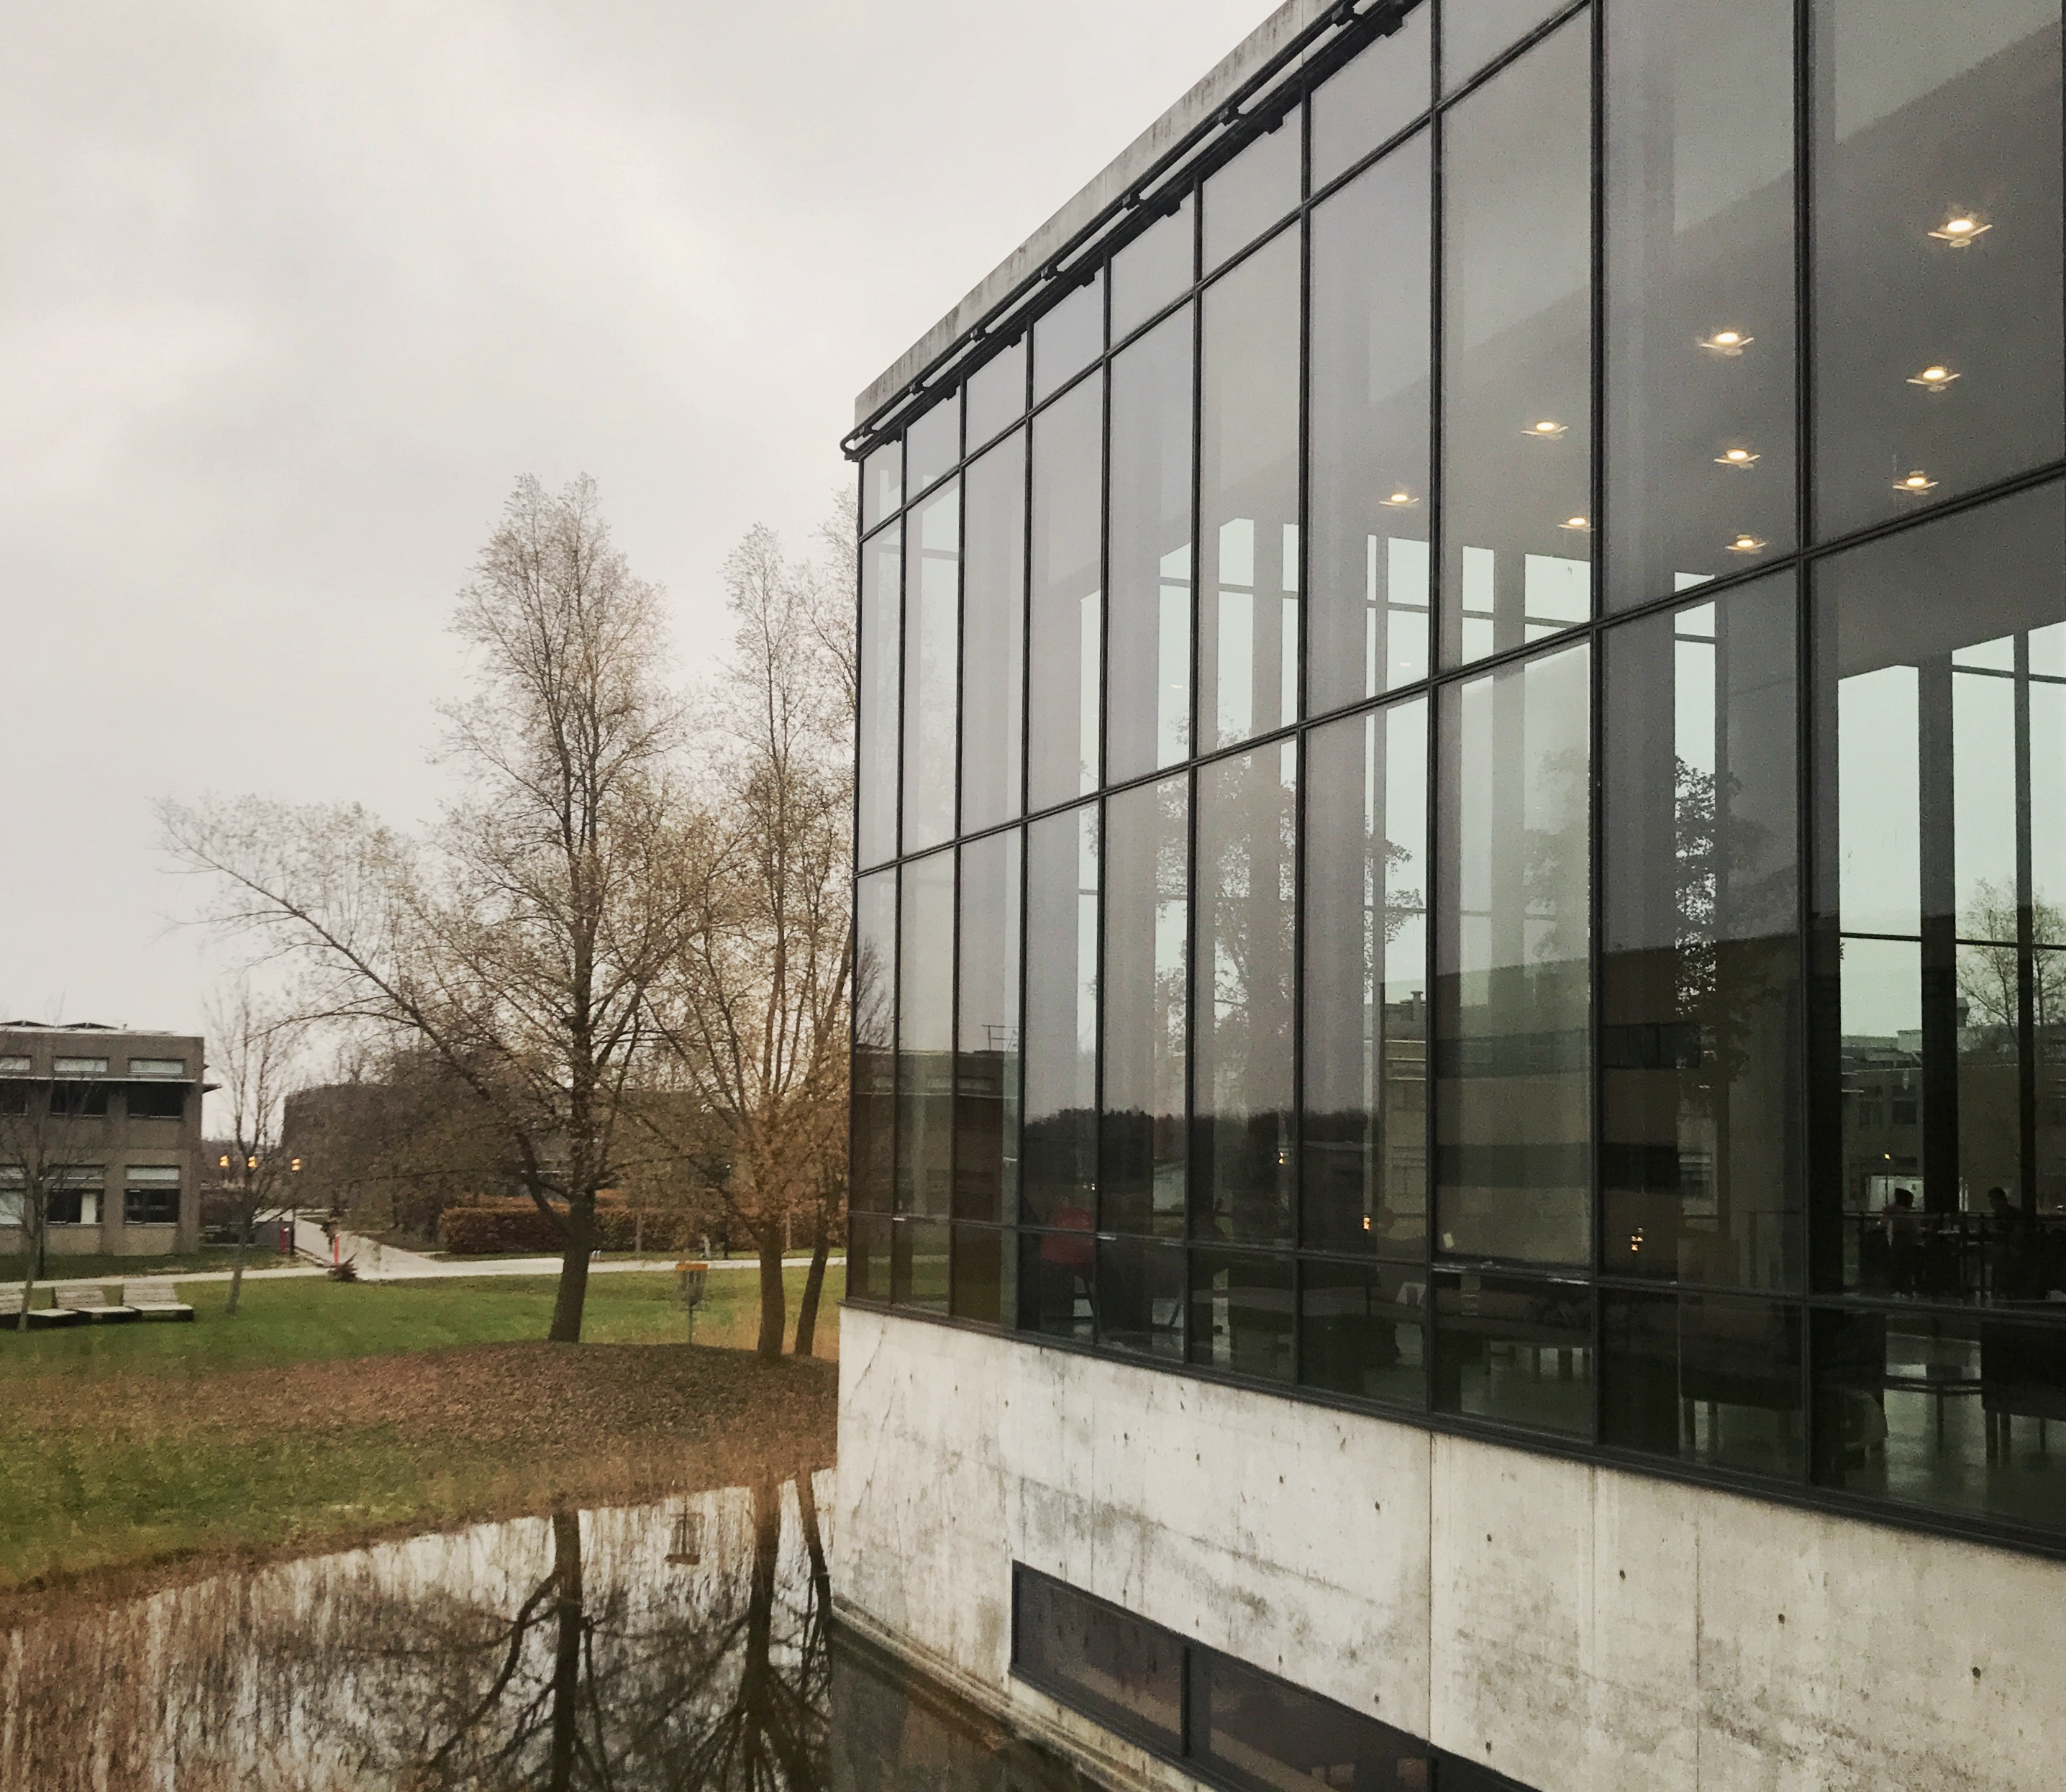
ABOUT US
Founded in 1971 (RUC 1972)
New library building 2001 – Henning Larsen Architects
Vibrant study environment for group work
11.000 shelf metres of books in open shelves
Open all days 8-24 with access card
Information desk open 9-15
Since October 2021 part of The Royal Danish Library
Notes:
INGER

Slide 4
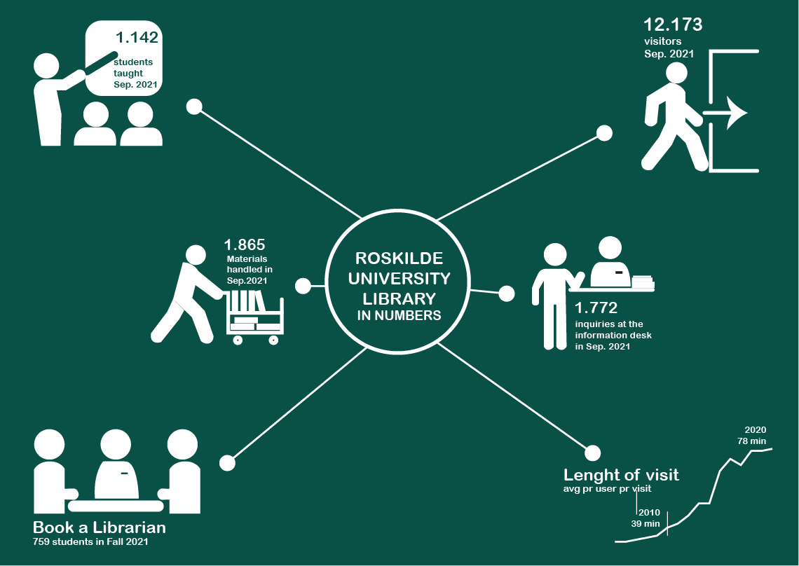

Slide 5

PPL AND INFORMATION LITERACY
RUC students spend 50% of their studies in participant driven projects. So-called PPL (Problem-oriented Project Learning)
Project groups design and carry out projects independently, but with supervison.
PPL therefore demands high levels of information competencies from the very first semester of studies at RUC.

Slide 6

LIBRARY COURSES AND TEACHING
Our aim is to reach students several times during their studies, but most importantly in their first semester.
1 hour-3½ hours workshop-based teaching.
Book a librarian

Slide 7

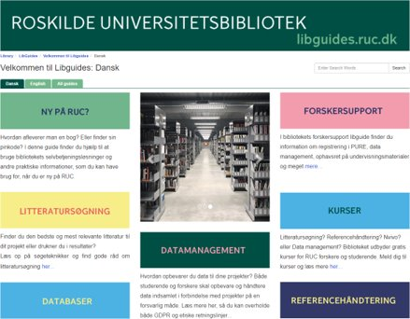
OPEN EDUCATIONAL RESOURCES
libguides.ruc.dk
Video.ruc.dk
Thirdroom
STAK platform and project

Slide 8
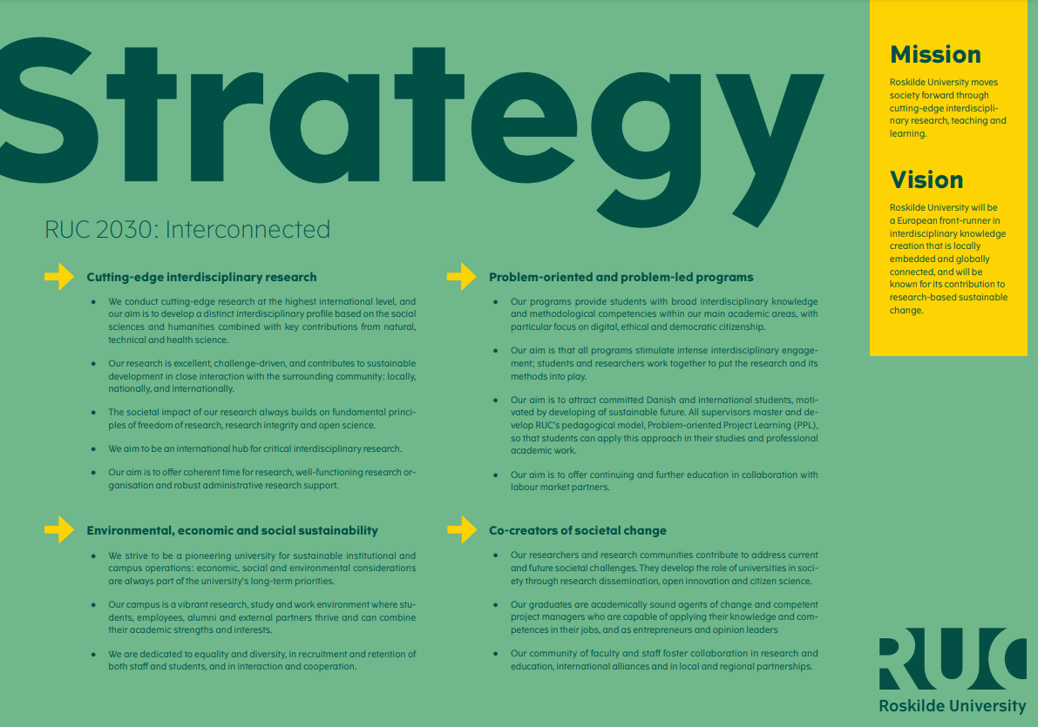
OPEN SCIENCE
RUC focus areas:
Citizen Science​
Responsible
Metrics​
FAIR Data​
Open Access​

Slide 9


CITIZEN SCIENCE AT RUC
- a work in progress
In RUC’s 2020 vision paper Citizen Science is defined in broad terms as citizens contributing with knowledge and/or labour as well as other methods of involvement, incl. participatory research and collaborative research

Slide 10
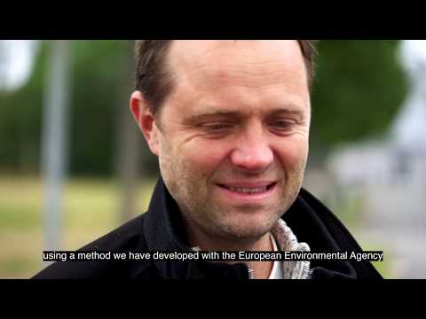
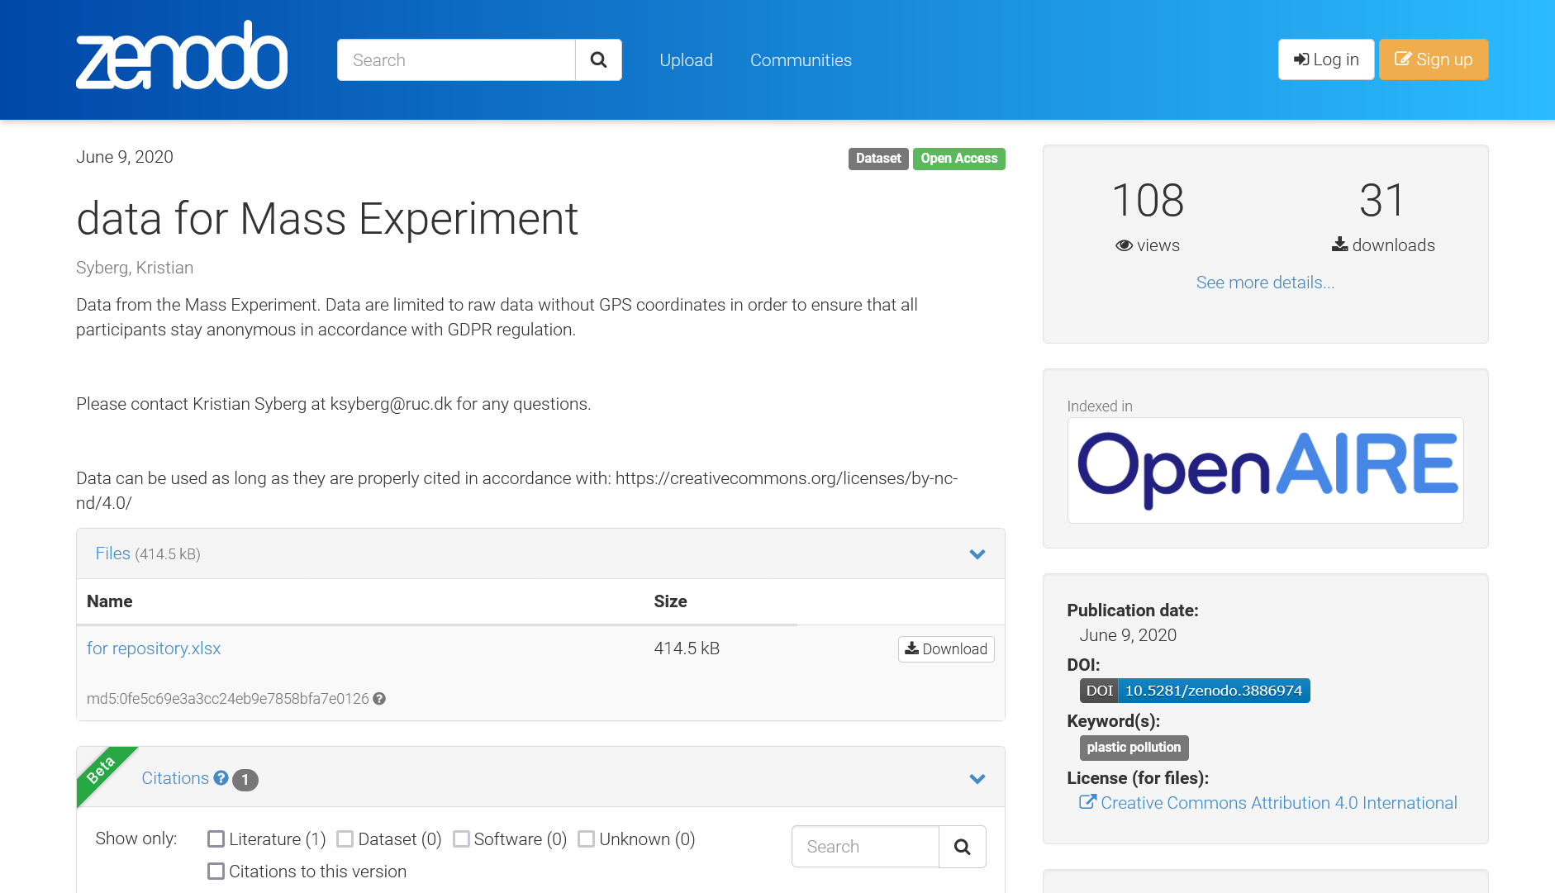
THE MASS EXPERIMENT
– an example of Citizen Science at RUC
Sources: https://youtu.be/uPIhOdDjaJw
https://ruc.dk/nyheder/forsker-faar-57000-forskningsassistenter
https://zenodo.org/record/3886974#.YnjiCOhBxaQ

Slide 11


RESPONSIBLE METRICS
- a black box
Community impact
Research blogs
Peer review
Mainstream media coverage
Publications
Editorial boards
Teaching

Slide 12
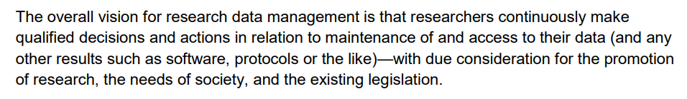
Denmark’s National Strategy for Data Management
- based on the FAIR principles
VISION
Source: https://www.deic.dk/sites/default/files/documents/PDF/National%20strategi%20for%20data%20management%20baseret%20pa%CC%8A%20FAIR%20principper%20(Ver%201.0)_EN.pdf
See also: https://doi.org/10.48715/ea59-tp35

Slide 13
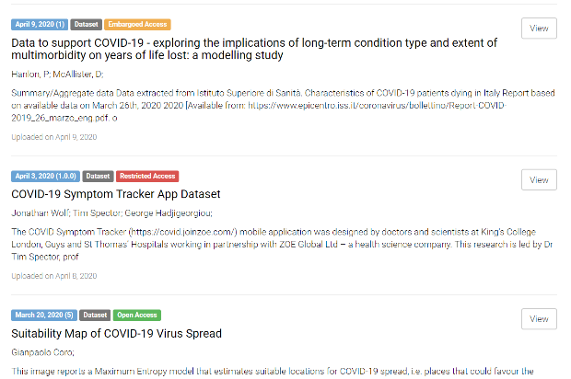






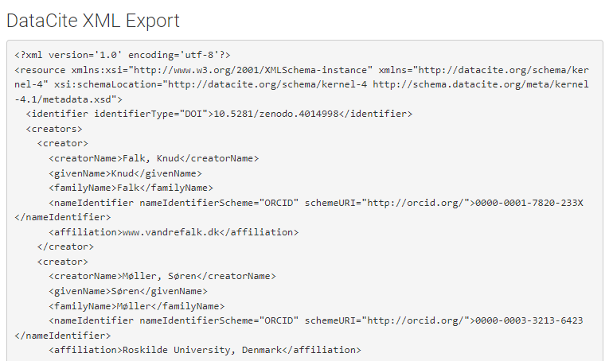
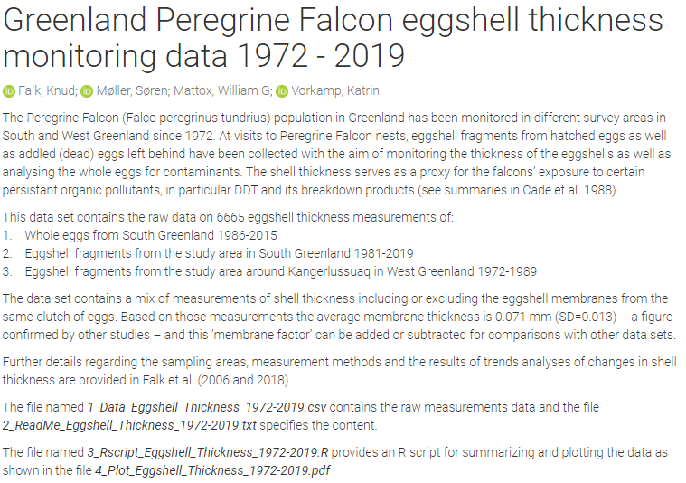
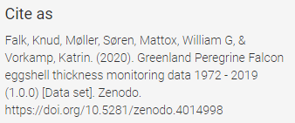
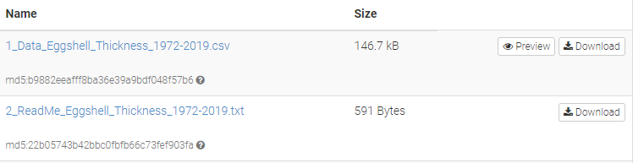
FAIR DATA
- as open as possible, as closed as necessary
Findable
Accessible
Interoperable
Reusable

Slide 14
FAIR DATA IN PRACTICE

Slide 15
IMPORTANCE OF FAIR DATA FOR
ROSKILDE UNIVERSITY
Transparency of the research process
Democratization of knowledge
Increase the possibility of solving major societal challenges
Visibility
New collaborations

Slide 16


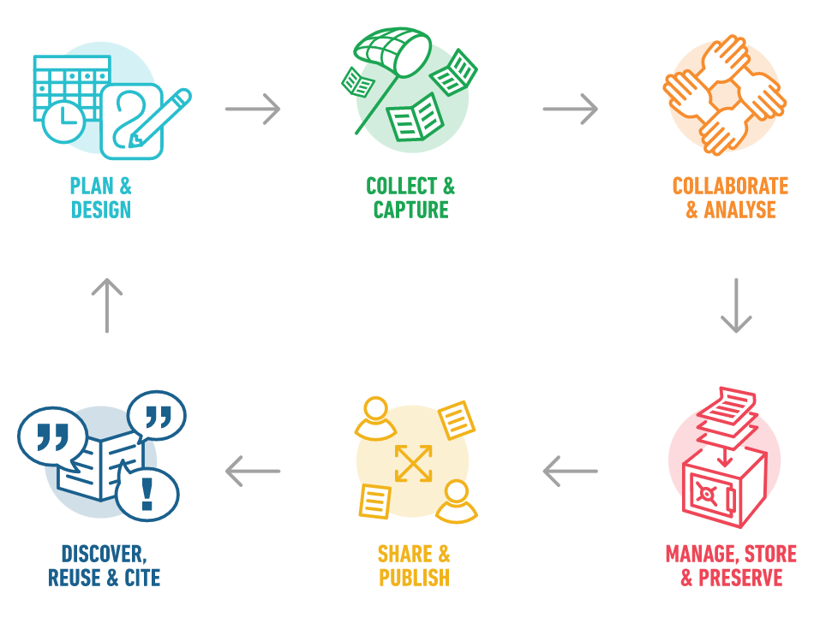

ROSKILDE UNIVERSITY LIBRARY'S CONTRIBUTION
Dataset Registration
Online Front Office
Data Management Plans
Competence Center

Slide 17


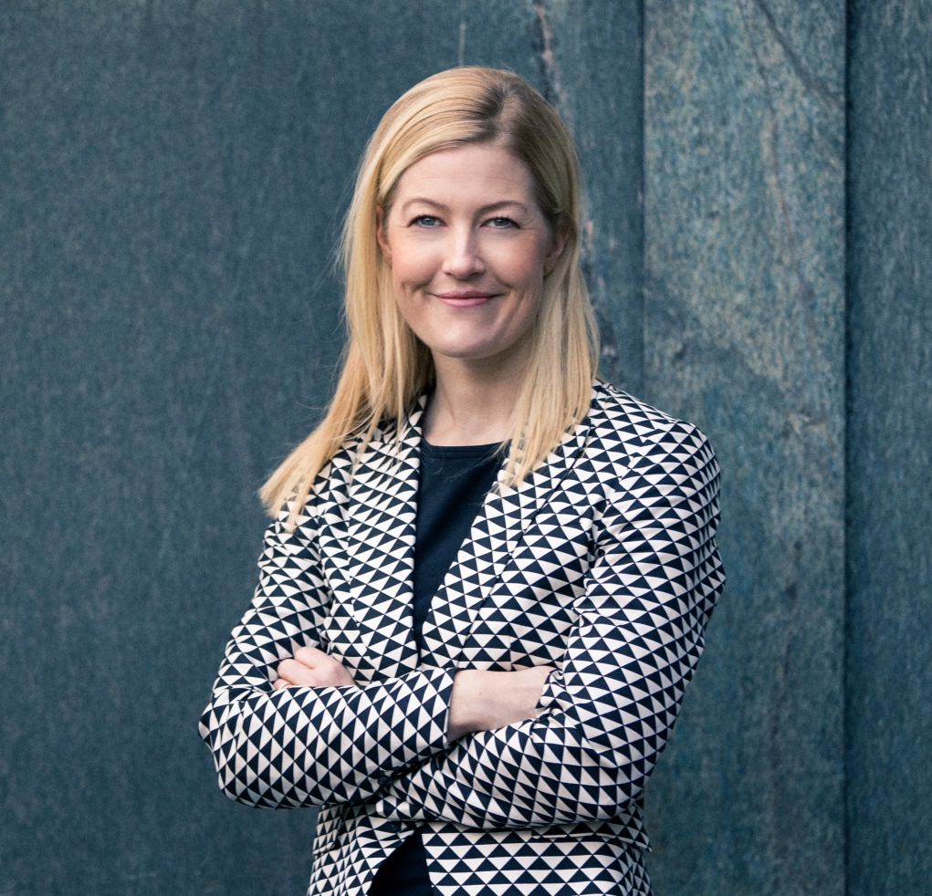
OPEN ACCESS
AT RUC
National Danish OA strategy from 2014 that all Danish Universities align with
RUC was an "early mover" and already from 2008 free access to research materials is mentioned in a digital strategy
Roskilde University Library has worked actively with Open Access since approx. 2010

Slide 18
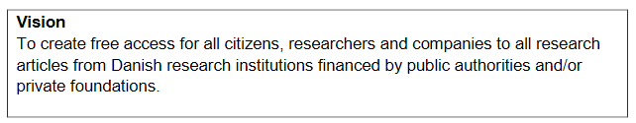
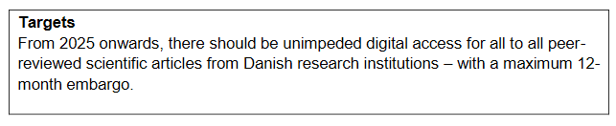

DENMARK’S NATIONAL STRATEGY FOR
OPEN ACCESS
Source: https://ufm.dk/en/research-and-innovation/cooperation-between-research-and-innovation/open-access/Publications/denmarks-national-strategy-for-open-access/national-strategy-for-open-access-english.pdf

Slide 19
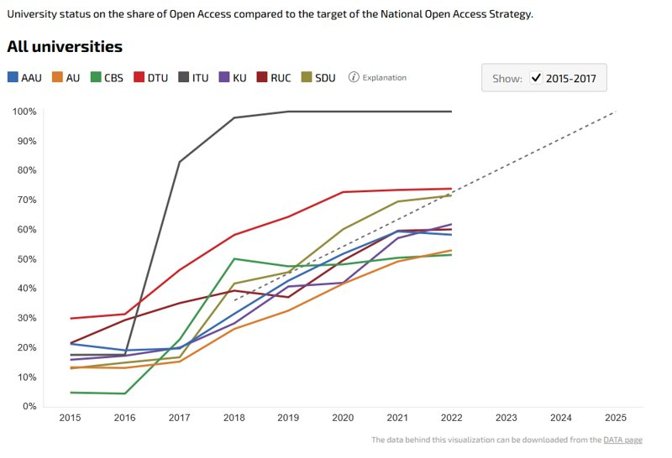

OA STATUS
Realised 60,08% 289/481
RUC
Source: https://oaindikator.dk/en/overview/local_historic#chart-0

Slide 20
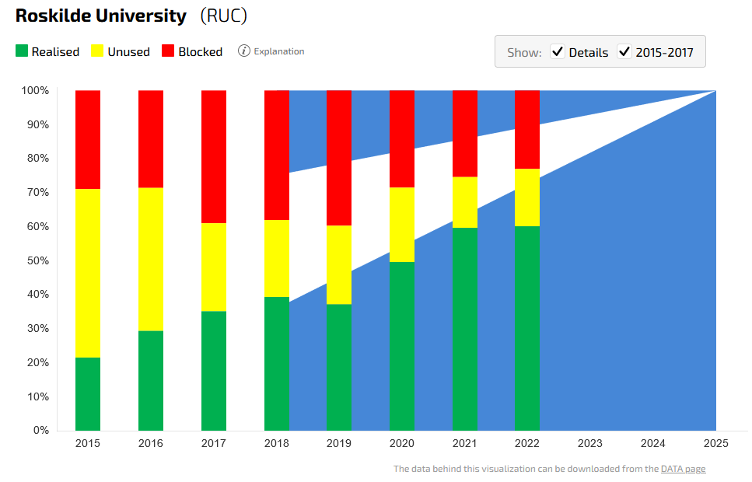
OA STATUS RUC
Realised 60,08%
Unused 16,84%
Blocked 23, 08%
Source: https://oaindikator.dk/en/overview/local_details_historic#chart-7

Slide 21


CONTACT US
Open Access
Sidse Louise Schelde (sils@kb.dk)
Data Management
Sacha Zurcher (sazu@kb.dk) & Pernille Nailor (pena@kb.dk)
Open Educational Resources
Inger Louise Berling Hyams (inhy@kb.dk)

Slide 22

DISCUSSION

